Slide 1


The Virginia Sexual and Domestic Violence Action Alliance is Virginia’s leading voice on sexual and intimate partner violence.
VAdata
2023 Update:
DOW Goes Digital
web: vsdvalliance.org
office: 804-377-0335
email: training@vsdvalliance.org
Notes:
Presented & last updated 1/24/2023.
Description: Beginning in February 2023, electronic Documenting Our Work (DOW) surveys will be available to survivors in all 11 languages that are available in print. The process for accessing eDOW survey data will also be greatly simplified! Join the Action Alliance for a free webinar on January 24 to learn about how your agency can use these tools to learn about the impact of your services. Our presentation will include an overview of the changes to the 2020 electronic DOW forms, information about new multilingual resources on internet safety, and a demonstration of the forms. Please feel free to contact the Data Systems and Evaluation team at vadataadmin@vsdvalliance.org for support or more information.

Slide 2
This module will cover…
Overview of the Documenting Our Work (DOW) project
How to use the updated online DOW surveys
Tech safety considerations and resources
A couple of notes about this file:
Some slides contain recorded screenshots as animated GIFs, which won’t be animated if this file is converted to PDF or printed.
View the recorded webinar (from January 24, 2023) at: https://youtu.be/qYTGPWFJi_U
Any hyperlinked text will be blue and underlined.
When opening any links, press the CTRL key and click the link to open it in your browser.

Slide 3
What is Documenting Our Work (DOW)?
DOW is a national project to understand the impact of advocacy.
This project was initiated through the Family Violence Prevention and Services Act (FVPSA) with support from the National Resource Center on Domestic Violence (NRCDV) in the late 1990s.
DOW surveys collect outcome data directly from survivors on the effects of services they received at local dual and domestic violence agencies.
There are 2 required outcomes that are tracked throughout all versions of this national project:
  “Because of the services I received from this program so far, I feel I know more about community resources.”
  “Because of the services I have received from this program so far, I feel I know more ways to plan for my safety.“

Slide 4
How do SV/DV agencies participate in Virginia?
In Virginia, we use two surveys to collect feedback from people receiving shelter services and community-based services.
These surveys collect information about the outcomes of advocacy services in two general settings. They do not evaluate specific services offered by an agency.
Both surveys were last updated in 2014 and are available in11 languages: English, Amharic, Arabic, Chinese, Dari, French, Korean, Pashto, Spanish, Tigrinya, and Vietnamese.
Inviting clients to participate is mandatory for agencies receiving VDSS funds. Go to VAdata Training Module 5 (Documenting Our Work) and VAdata Training Module 10 (VDSS Outcome Report) for more details.

Slide 5
When should we invite clients to complete DOW surveys?
We suggest the following:
  Community-Based Services: Invite each adult who receives services from your agency to fill out a survey on at least 3 different dates, several weeks apart.
  Shelter Services: Invite residents to complete a survey at the point that you think they are about mid-way through their shelter stay and/or at the end of their stay.
The most important thing is having consistency and shared expectations with your coworkers about inviting clients to participate!

Slide 6
Is it mandatory for VDSS-funded agencies to use the online DOW forms?
No! The online forms are just one way to fill out DOW surveys. Offering clients the opportunity to provide feedback is what matters most.
If people are more comfortable with paper forms, or it isn’t safe to access the online survey, they are welcome to continue to use paper forms.
Clients can also answer questions by phone, if it is safe to communicate and the client is surveyed by someone at the agency who did not directly provide services to them. The person surveying the client can enter answers in the online form or fill out a paper survey.

Slide 7
How can we use our DOW results?
DOW data can get used in many ways! These are just a few ideas.
Statewide data:
  Annual ‘Advocacy in Virginia’ infographic created by the Action Alliance
  Data requests, especially from researchers or state partners
Grant writing and reporting
  VDSS Outcomes
  Performance data for other grants (OVW, HUD, etc.)
Community outreach materials
Strategic planning and continuous improvement at your agency

Slide 8
Using the online DOW forms in 4 steps
Get your agency’s 2 unique DOW URLs for Shelter and Community surveys
1
Talk to clients about safe internet access and invite them to respond
2
Wait 90 days per anonymity protocol
3
Access cumulative responses in VAdata
4

Slide 9
How do the online forms work?
The Action Alliance maintains DOW survey forms in Qualtrics. Responses get uploaded to VAdata twice a month.
Each agency gets 2 unique URLs (web addresses) that can be shared with clients. One URL is the form for shelter-based services, and the other is the form for community-based services.
All languages can be accessed on these 2 forms without going to a different web address. Just change the language in the upper right-hand corner.
Both forms are mobile-friendly and formatted to be easy to read.

Slide 10
How do we know which URLs correspond to which agency?
By February 1, 2023 Action Alliance staff will have emailed the URLs to agency directors and VAdata contacts! You can also ask us at vadataadmin@vsdvalliance.org.
At the end of each URL, you’ll see a set of characters after a question mark. This is called a query string. There is a different query string for each agency, and it reflects the VAdata agency ID. If you ever used SurveyMonkey, this is similar to a “collector.”
It will look like this: ?v=### but the ### will be your VAdata agency ID.
TIPS:
If you leave the query string off the URL, clients can submit DOW responses, but Action Alliance staff will have no way of knowing which responses are for your agency.
Look in the upper right-hand corner of the printable DOW forms for this agency number.
Save the full URLs with query strings somewhere you and your teammates can access them!
Does your agency use multiple VAdata IDs? Please call or email us to discuss.

Slide 11
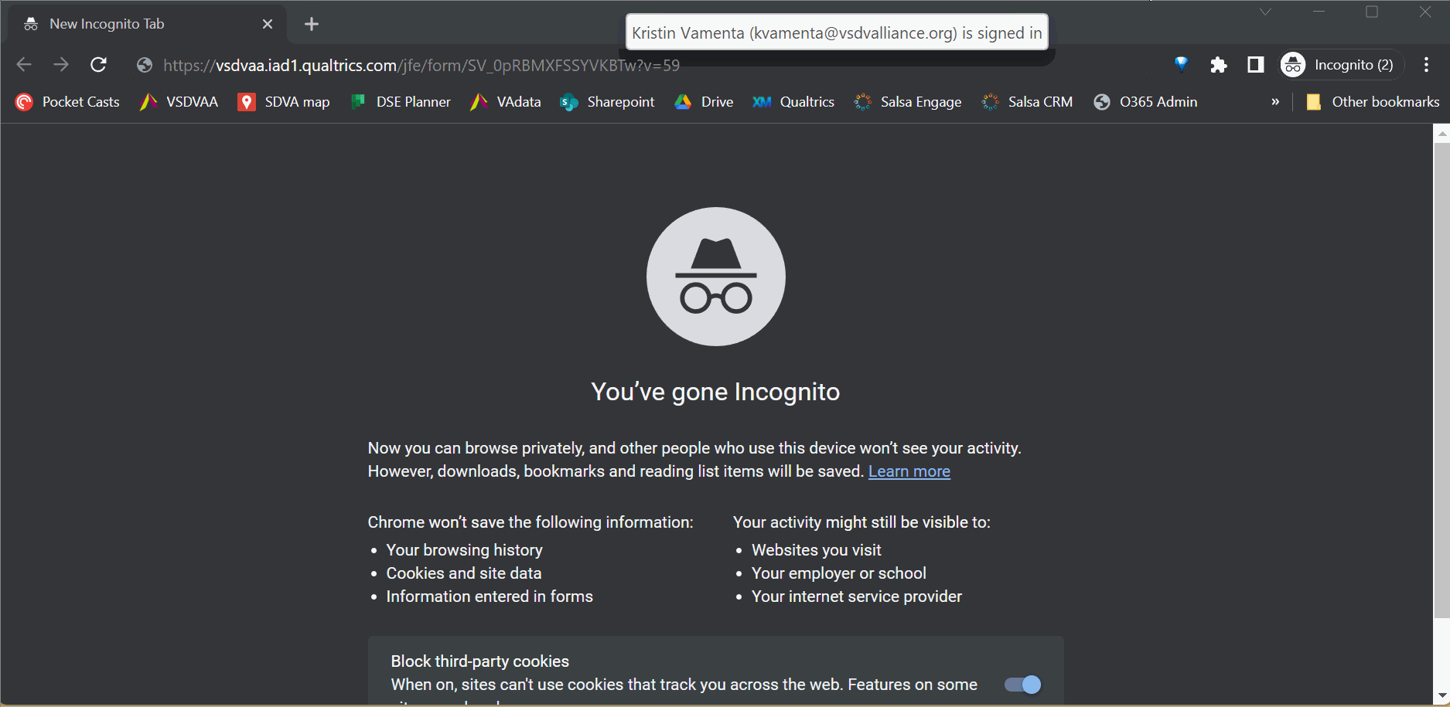
Example: Shelter Form, English

Slide 12
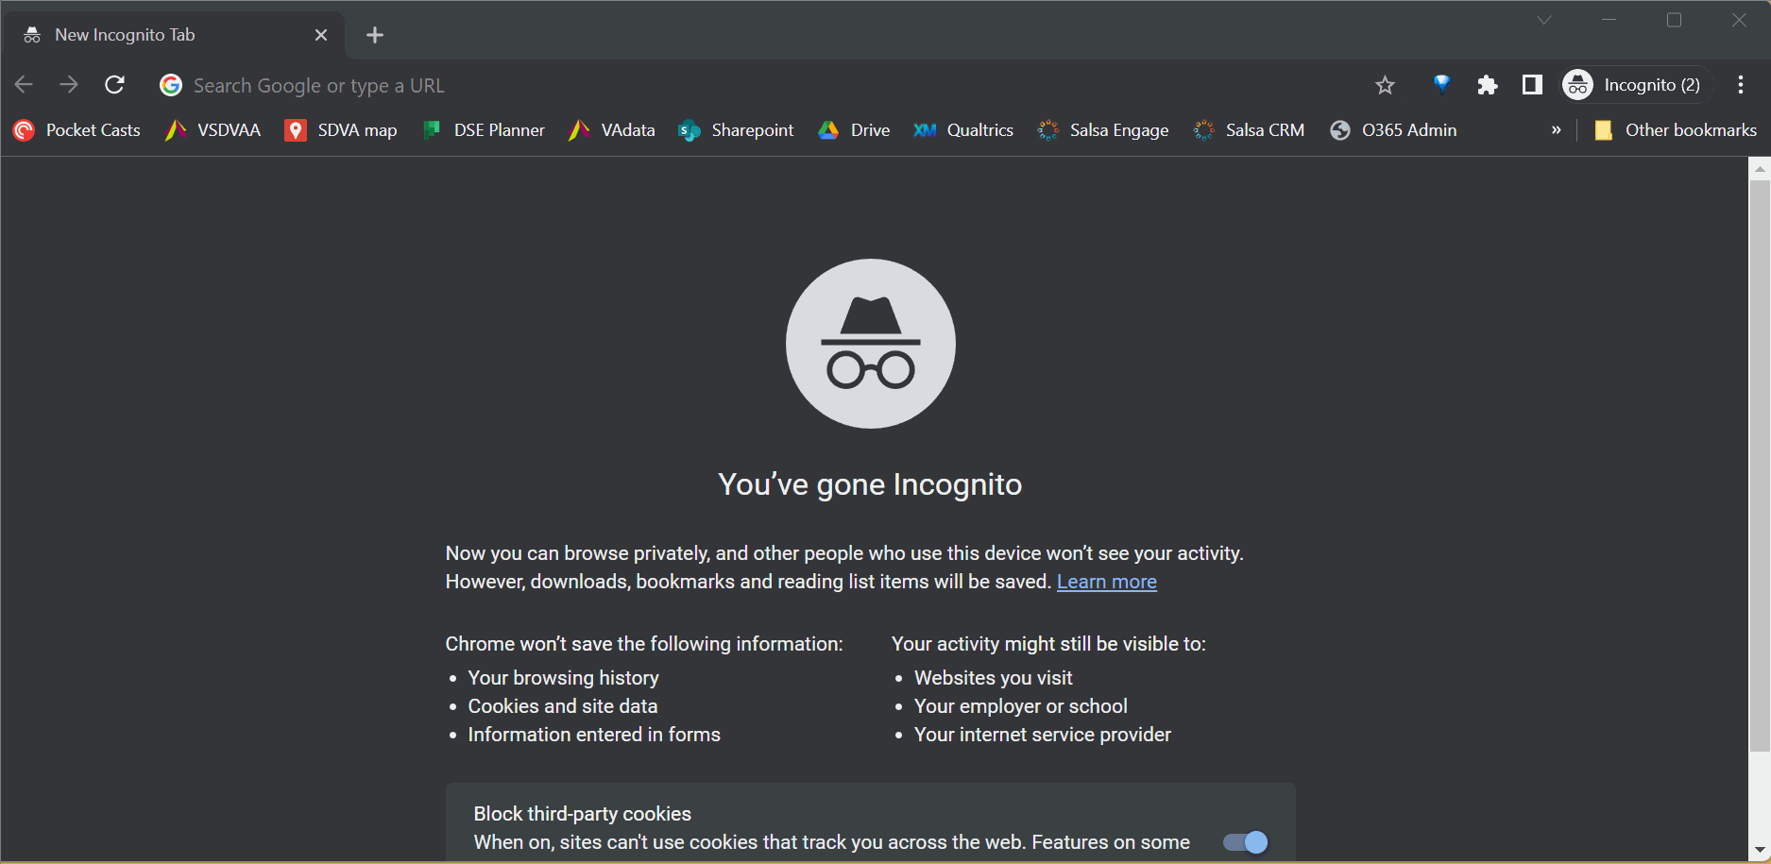
Example: Community Form, Arabic

Slide 13
How do agencies access survey data from the online forms?
Action Alliance staff will download survey responses from Qualtrics twice a month.
  Answers to open-ended questions will be reviewed after each download for the ‘audit’ to redact sensitive information, just like the paper forms.
  Then, we’ll upload CSV files with downloaded, redacted responses into VAdata.
Starting in February 2023, the Action Alliance will send monthly emails to local agencies with the number of online DOW surveys received.
  This will only provide information on the number and type (Community or Shelter) of surveys received.
  Remember that the 90-day time lapse still applies before agency staff can access summary DOW data through VAdata. This time lapse protects the privacy and confidentiality of responses and allows us to coordinate translation of open-ended responses.

Slide 14
How does the Action Alliance protect survivors’ DOW responses?
Limiting who can access data
Collecting minimal data
Anonymity protocol
Local and state agencies can only view aggregate responses for a specific time period, not individual surveys.
Open-ended responses are redacted by trained staff with signed confidentiality agreements.
Only VAdata support staff can access raw DOW data (Tamara, Kristin, Itzel).
Translators, data entry staff, and anyone supporting this project must sign confidentiality agreements.
Only the responses to open-ended questions are shared with translators, and only for a limited time. .
Like VAdata, DOW forms in Qualtrics don’t collect names, addresses, IP information, or anything that can be identifying.

Slide 15
How can clients access online DOW surveys safely?
Confidentiality is a practice that supports survivors’ autonomy.
When possible, we recommend that clients use agency devices and agency internet access to access the surveys. We expect this is more likely to be possible in the context of shelter and support groups when meeting in person.
If you explain the risks of using personal devices and personally-managed internet access and the client wishes to continue using their own tools, respect that choice – survivors know their risks better than anyone.

Slide 16
Core recommendations for clients’ tech safety
The form should be accessed:
  using a browser in private mode,
  on a device that is secure (not being monitored), and
  on a secure network
Safety planning should be discussed with clients prior to sending them the URL. If emailed, make sure the link is sent to a secure email address in addition to the recommendations above.
If client doesn't feel safe enough to complete the survey, or if they suspect that someone may be monitoring their device and/or internet use, then they should talk to an advocate about their safety. The survey can wait!

Slide 17
Key questions: safety planning with tech abuse
What damage has taken place?
How could the abuser have gained access to this information?
What other abusive tactics are being used?
What information does the survivor want to protect the most?
What results or outcomes does the client want?

Slide 18

Your tech safety toolbox
NOTE: Some situations are more complex – but you don’t have to tackle them alone. Don’t hesitate to connect with us or our legal team!
Take inventory
  Devices
  Accounts and apps
  Messages and communication
  Internet usage and digital footprint
Improve security of important accounts/devices
Keep records of the abuse
Discuss safety/wellness needs with others

Slide 19


Where can I learn more about safety planning with technology?
Reach out to the Action Alliance! Tamara, Kristin, Itzel, and other staff can answer questions and offer trainings on confidentiality and safety planning with technology.
Check out the plain language, multilingual Internet Safety guides, which are also on our website: https://vsdvalliance.org/get-help-ayuda/resources/

Slide 20
Additional resources: tech safety planning
NNEDV Safety Net, How to Talk with Survivors About Safe Methods of Contact.
NNEDV Safety Net, Assessing for Technology Abuse & Privacy Concerns.
NNEDV Safety Net, Assessing for Technology Misuse & Privacy Concerns with Sexual Assault Survivors.
Cornell Tech Clinic to End Tech Abuse, Technology Assessment Questionnaire (TAQ).

Slide 21
In summary…
DOW, as an outcome evaluation tool, helps agencies and advocates understand the impact of DV/IPV advocacy services.
Each agency gets 1 link for Community and 1 link for Shelter, connected to their VAdata Program ID. All 11 languages are available on both survey forms.
New survey links will be live on February 1, 2023. Action Alliance staff will email all directors and VAdata contacts with the new agency links.
Technology is a key part of survivors’ lives and crucial to our work as advocates.

Slide 22
What do I do if there’s something wrong with VAdata or DOW forms?
We don’t use VAdata in the same ways you do! Sometimes the only way that we know something is off or broken is when you tell us.
When you have questions, we like to talk with you by phone or do a video call. We often want information or context that you might not know we need.
If you think something is wrong with VAdata or your DOW forms, please let us know! Give us a call at 804.377.0335 OR email us at vadataadmin@vsdvalliance.org.

Slide 23



You can also reach out using our direct emails!
Tamara Mason
Kristin Vamenta
Itzel Patiño
tmason@vsdvalliance.org
SDVA Data Systems Director
kvamenta@vsdvalliance.org
Evaluation and Technology Safety Manager
ipatino@vsdvalliance.org
Housing and Advocacy Coordinator

Slide 24
How can I get help on other topics?
The Action Alliance staff encourages you to contact us whenever you have a question or a concern about data and evaluation, resources, advocacy,prevention, policy, training, funding, or anything else.
Staff can be reached at
804.377.0335
Or you can visit our website to send a message directly to staff: https://vsdvalliance.org/contact/.

